Slide 1
Mining Sequence Data

Slide 2
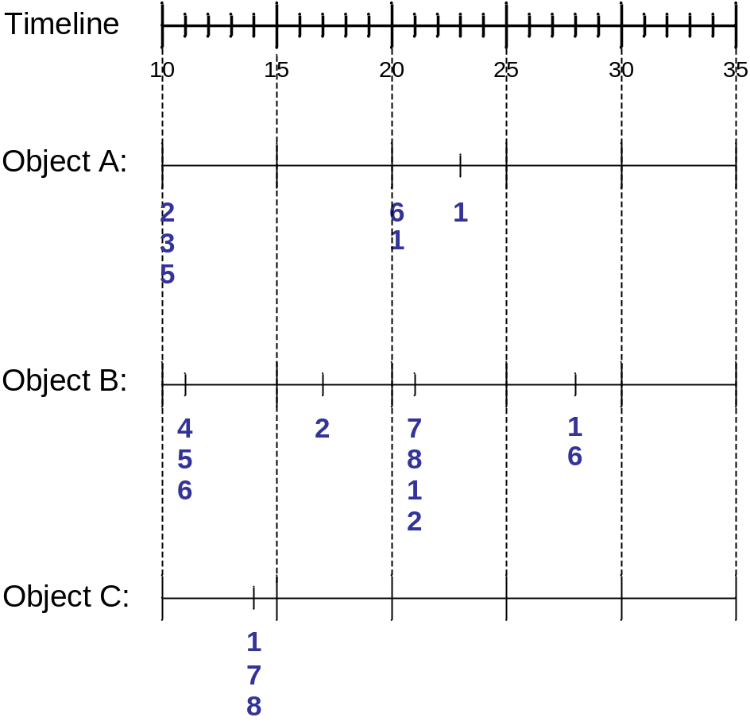
Sequence Data
Sequence Database:
Object
Timestamp
Events
A
10
2, 3, 5
A
20
6, 1
A
23
1
B
11
4, 5, 6
B
17
2
B
21
7, 8, 1, 2
B
28
1, 6
C
14
1, 8, 7

Slide 3
Examples of Sequence Data
Sequence Database | Sequence | Element (Transaction) | Event (Item)
Customer | Purchase history of a given customer | A set of items bought by a customer at time t | Books, diary products, CDs, etc
Web Data | Browsing activity of a particular Web visitor | A collection of files viewed by a Web visitor after a single mouse click | Home page, index page, contact info, etc
Event data | History of events generated by a given sensor | Events triggered by a sensor at time t | Types of alarms generated by sensors
Genome sequences | DNA sequence of a particular species | An element of the DNA sequence | Bases A,T,G,C
Element (Transaction)
Event
(Item)
E1
E2
E1
E3
E2
E2
E3
E4
Sequence

Slide 4
Formal Definition of a Sequence
A sequence is an ordered list of elements (transactions)
  s = < e₁ e₂ e₃ … >
  Each element contains a collection of events (items)
  e_{i} = {i₁, i₂, …, i_{k}}
  Each element is attributed to a specific time or location
Length of a sequence, |s|, is given by the number of elements of the sequence
A k-sequence is a sequence that contains k events (items)

Slide 5
Examples of Sequence
Web sequence:
  < {Homepage} {Electronics} {Digital Cameras} {Canon Digital Camera} {Shopping Cart} {Order Confirmation} {Return to Shopping} >
Sequence of initiating events causing the nuclear accident at 3-mile Island:
(http://stellar-one.com/nuclear/staff_reports/summary_SOE_the_initiating_event.htm)
  < {clogged resin} {outlet valve closure} {loss of feedwater}
  {condenser polisher outlet valve shut} {booster pumps trip}
  {main waterpump trips} {main turbine trips} {reactor pressure increases}>
Sequence of books checked out at a library:
  <{Fellowship of the Ring} {The Two Towers} {Return of the King}>

Slide 6
Formal Definition of a Subsequence
A sequence <a₁ a₂ … a_{n}> is contained in another sequence <b₁ b₂ … b_{m}> (m ≥ n) if there exist integers
i₁ < i₂ < … < i_{n} such that a₁ ⊆ b_{i1} , a₂ ⊆ b_{i1}, …, a_{n} ⊆ b_{in}
The support of a subsequence w is defined as the fraction of data sequences that contain w
A sequential pattern is a frequent subsequence (i.e., a subsequence whose support is ≥ minsup)
Data sequence | Subsequence | Contain?
< {2,4} {3,5,6} {8} > | < {2} {3,5} > | Yes
< {1,2} {3,4} > | < {1} {2} > | No
< {2,4} {2,4} {2,5} > | < {2} {4} > | Yes

Slide 7
Sequential Pattern Mining: Definition
Given:
  a database of sequences
  a user-specified minimum support threshold, minsup
Task:
  Find all subsequences with support ≥ minsup

Slide 8
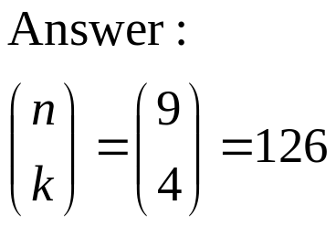
Sequential Pattern Mining: Challenge
Given a sequence: <{a b} {c d e} {f} {g h i}>
  Examples of subsequences:
    <{a} {c d} {f} {g} >, < {c d e} >, < {b} {g} >, etc.
How many k-subsequences can be extracted from a given n-sequence?
<{a b} {c d e} {f} {g h i}> n = 9
k=4: Y _ _ Y Y _ _ _ Y
<{a} {d e} {i}>

Slide 9
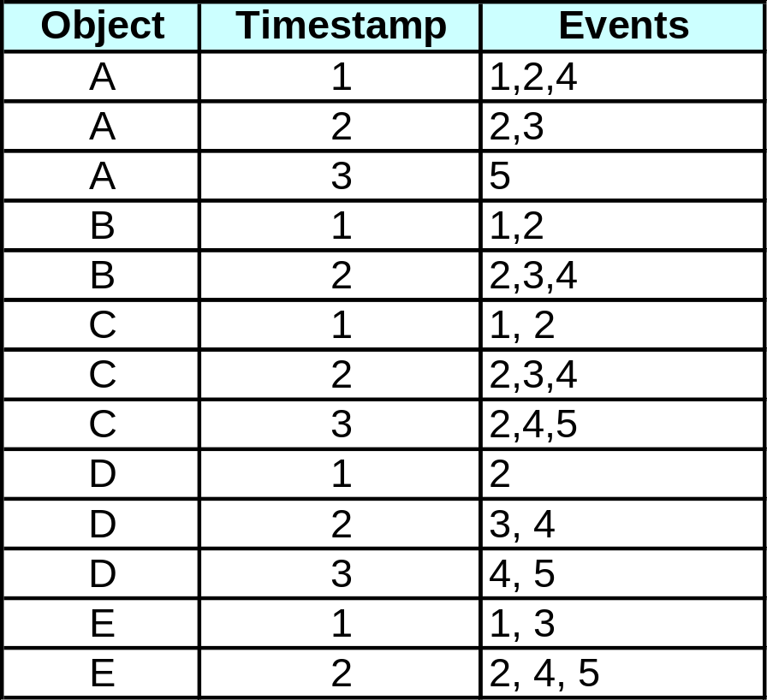
Sequential Pattern Mining: Example
Minsup = 50%
Examples of Frequent Subsequences:
< {1,2} > s=60%
< {2,3} > s=60%
< {2,4}> s=80%
< {3} {5}> s=80%
< {1} {2} > s=80%
< {2} {2} > s=60%
< {1} {2,3} > s=60%
< {2} {2,3} > s=60%
< {1,2} {2,3} > s=60%

Slide 10
Extracting Sequential Patterns
Given n events: i₁, i₂, i₃, …, i_{n}
Candidate 1-subsequences:
    <{i₁}>, <{i₂}>, <{i₃}>, …, <{i_{n}}>
Candidate 2-subsequences:
    <{i₁, i₂}>, <{i₁, i₃}>, …, <{i₁} {i₁}>, <{i₁} {i₂}>, …, <{i_{n-1}} {i_{n}}>
Candidate 3-subsequences:
    <{i₁, i₂ , i₃}>, <{i₁, i₂ , i₄}>, …, <{i₁, i₂} {i₁}>, <{i₁, i₂} {i₂}>, …,
    <{i₁} {i₁ , i₂}>, <{i₁} {i₁ , i₃}>, …, <{i₁} {i₁} {i₁}>, <{i₁} {i₁} {i₂}>, …

Slide 11
Generalized Sequential Pattern (GSP)
Step 1:
  Make the first pass over the sequence database D to yield all the 1-element frequent sequences
Step 2:
Repeat until no new frequent sequences are found
  Candidate Generation:
    Merge pairs of frequent subsequences found in the (k-1)th pass to generate candidate sequences that contain k items
  Candidate Pruning:
    Prune candidate k-sequences that contain infrequent (k-1)-subsequences
  Support Counting:
    Make a new pass over the sequence database D to find the support for these candidate sequences
  Candidate Elimination:
    Eliminate candidate k-sequences whose actual support is less than minsup

Slide 12
Candidate Generation
Base case (k=2):
  Merging two frequent 1-sequences <{i₁}> and <{i₂}> will produce two candidate 2-sequences: <{i₁} {i₂}> and <{i₁ i₂}>
General case (k>2):
  A frequent (k-1)-sequence w₁ is merged with another frequent
  (k-1)-sequence w₂ to produce a candidate k-sequence if the subsequence obtained by removing the first event in w₁ is the same as the subsequence obtained by removing the last event in w₂
    The resulting candidate after merging is given by the sequence w₁ extended with the last event of w₂.
      If the last two events in w₂ belong to the same element, then the last event in w₂ becomes part of the last element in w₁
      Otherwise, the last event in w₂ becomes a separate element appended to the end of w₁

Slide 13
Candidate Generation Examples
Merging the sequences
w₁=<{1} {2 3} {4}> and w₂ =<{2 3} {4 5}>
will produce the candidate sequence < {1} {2 3} {4 5}> because the last two events in w₂ (4 and 5) belong to the same element
Merging the sequences
w₁=<{1} {2 3} {4}> and w₂ =<{2 3} {4} {5}>
will produce the candidate sequence < {1} {2 3} {4} {5}> because the last two events in w₂ (4 and 5) do not belong to the same element
We do not have to merge the sequences
w₁ =<{1} {2 6} {4}> and w₂ =<{1} {2} {4 5}>
to produce the candidate < {1} {2 6} {4 5}> because if the latter is a viable candidate, then it can be obtained by merging w₁ with
< {1} {2 6} {4 5}>

Slide 14
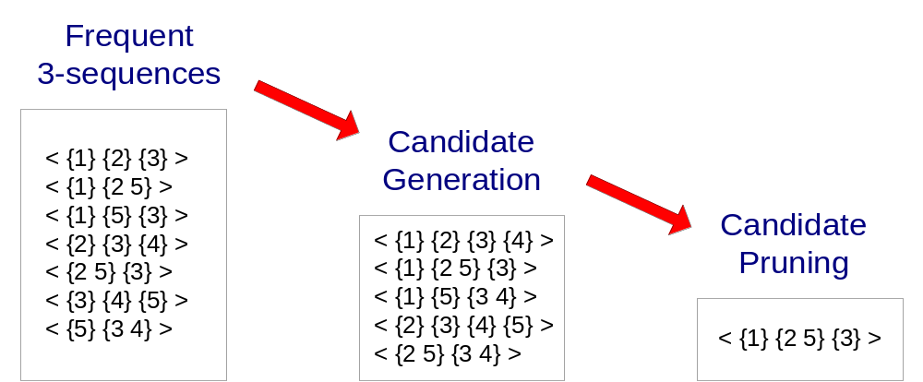
GSP Example

Slide 15
Timing Constraints (I)
{A B} {C} {D E}
x_{g}: max-gap
n_{g}: min-gap
m_{s}: maximum span
<= x_{g}
>n_{g}
<= m_{s}
x_{g} = 2, n_{g} = 0, m_{s}= 4
Data sequence | Subsequence | Contain?
< {2,4} {3,5,6} {4,7} {4,5} {8} > | < {6} {5} > | Yes
< {1} {2} {3} {4} {5}> | < {1} {4} > | No
< {1} {2,3} {3,4} {4,5}> | < {2} {3} {5} > | Yes
< {1,2} {3} {2,3} {3,4} {2,4} {4,5}> | < {1,2} {5} > | No

Slide 16
Mining Sequential Patterns with Timing Constraints
Approach 1:
  Mine sequential patterns without timing constraints
  Postprocess the discovered patterns
Approach 2:
  Modify GSP to directly prune candidates that violate timing constraints
  Question:
    Does Apriori principle still hold?

Slide 17
Apriori Principle for Sequence Data
Suppose:
x_{g} = 1 (max-gap)
n_{g} = 0 (min-gap)
m_{s} = 5 (maximum span)
minsup = 60%
<{2} {5}> support = 40%
but
<{2} {3} {5}> support = 60%
Problem exists because of max-gap constraint
No such problem if max-gap is infinite

Slide 18
Contiguous Subsequences
s is a contiguous subsequence of
w = <e₁>< e₂>…< e_{k}>
if any of the following conditions hold:
  s is obtained from w by deleting an item from either e₁ or e_{k}
  s is obtained from w by deleting an item from any element e_{i} that contains more than 2 items
  s is a contiguous subsequence of s’ and s’ is a contiguous subsequence of w (recursive definition)
Examples: s = < {1} {2} >
  is a contiguous subsequence of
  < {1} {2 3}>, < {1 2} {2} {3}>, and < {3 4} {1 2} {2 3} {4} >
  is not a contiguous subsequence of
  < {1} {3} {2}> and < {2} {1} {3} {2}>

Slide 19
Modified Candidate Pruning Step
Without maxgap constraint:
  A candidate k-sequence is pruned if at least one of its (k-1)-subsequences is infrequent
With maxgap constraint:
  A candidate k-sequence is pruned if at least one of its contiguous (k-1)-subsequences is infrequent

Slide 20
Timing Constraints (II)
x_{g}: max-gap
n_{g}: min-gap
ws: window size
m_{s}: maximum span
{A B} {C} {D E}
<= x_{g}
>n_{g}
<= ws
<= m_{s}
x_{g} = 2, n_{g} = 0, ws = 1, m_{s}= 5
Data sequence | Subsequence | Contain?
< {2,4} {3,5,6} {4,7} {4,6} {8} > | < {3} {5} > | No
< {1} {2} {3} {4} {5}> | < {1,2} {3} > | Yes
< {1,2} {2,3} {3,4} {4,5}> | < {1,2} {3,4} > | Yes

Slide 21
Modified Support Counting Step
Given a candidate pattern: <{a, c}>
  Any data sequences that contain
  <… {a c} … >,
  <… {a} … {c}…> ( where time({c}) – time({a}) ≤ ws)
  <…{c} … {a} …> (where time({a}) – time({c}) ≤ ws)
  will contribute to the support count of candidate pattern

